Slide 1
Stress Sense: Machine Learning Driven Stress Profiling from Apple Health Data
Presented by
Sujan Manohar Prodduturi

Slide 2
INTRODUCTION
Wearables like Apple watch collect continuous HRV, HR, sleep, and activity data
Commercial stress scores are opaque and non-personalized
Users lack clear explanations for stress fluctuations
StressSense provides a transparent, science-based alternative
Uses Apple Health data + feature engineering + machine learning

Slide 3
PROBLEM STATEMENT
HRV VARIES SIGNIFICANTLY BETWEEN INDIVIDUALS
ONE-SIZE-FITS-ALL STRESS THRESHOLDS ARE UNRELIABLE
WEARABLE DATA IS NOISY, IRREGULAR, AND CONTEXT DEPENDENT
NEED FOR A PERSONALIZED, EXPLAINABLE STRESS DETECTION SYSTEM

Slide 4
PROJECT GOAL
BUILD A PERSONALIZED STRESS-DETECTION SYSTEM USING APPLE WATCH DATA
CREATE A ROLLING HRV BASELINE TO CAPTURE EACH PERSON’S NORMAL PHYSIOLOGY
ENGINEER MEANINGFUL FEATURES FROM HEART RATE, SLEEP, AND ACTIVITY PATTERNS
TRAIN ML MODELS TO CLASSIFY STRESS VS. NON-STRESS DAYS WHICH IN TURN PROVIDES INTERPRETABLE, ACTIONABLE INSIGHTS USING SHAP EXPLANATIONS

Slide 5
Why Stress Detection Matters?
Stress affects energy, focus, sleep, recovery, and long-term health
Early detection helps prevent burnout and chronic fatigue
Physiological stress often appears before we feel it subjectively
Personalized stress insights support better training, recovery, and daily decisions
Understanding stress patterns leads to healthier habits and improved well-being

Slide 6
PROJECT KEYWORDS
HRV (SDNN) - Heart Rate Variability (Standard Deviation of Normal-to-Normal inter-beat intervals)
Resting Heart Rate (RHR) - Resting Heart Rate
HRV Baseline – Heart Rate Variability Baseline
HRV Deviation - Heart Rate Variability Deviation
Lag Features
Rolling Averages
Activity Load
Cardio Strain
Logistic Regression
Random Forest
ROC-AUC
SHAP Values

Slide 7
Dataset Overview
Apple Health (iPhone + Apple Watch) data from Sept 2022 – Dec 2025
Includes HRV, HR, RHR, sleep, steps, active energy

Slide 8
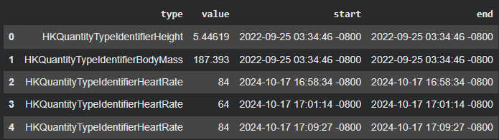
RAW APPLE HEALTH DATA
Requires significant preprocessing to convert irregular events into daily metrics

Slide 9
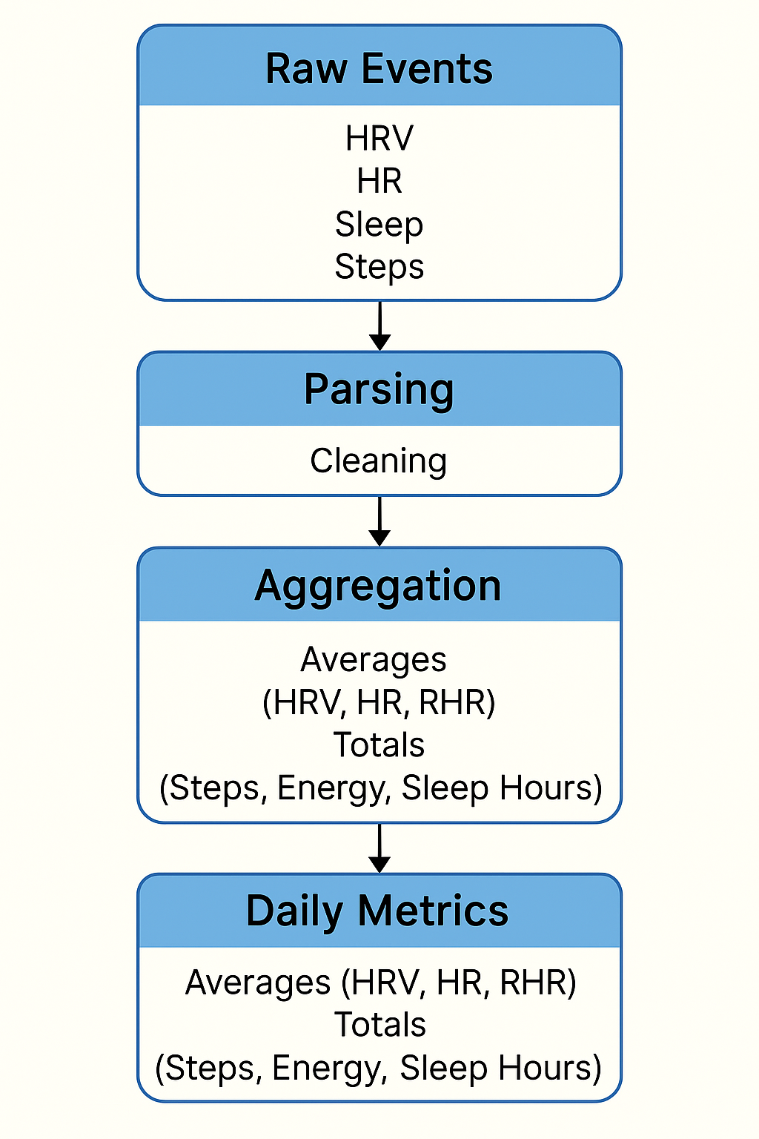
DATA PREPROCESSING
Parsed Apple Health XML to extract HRV, heart rate, sleep, steps, and energy events
Standardized timestamps and converted raw string values into numeric formats
Aggregated irregular event-level data into consistent daily metrics
Built a 14-day rolling HRV baseline to personalize stress interpretation
Computed HRV deviation and generated the physiologically grounded stress label
Handled missing values using median imputation and rolling averages
Sorted data chronologically to preserve temporal integrity for modeling

Slide 10
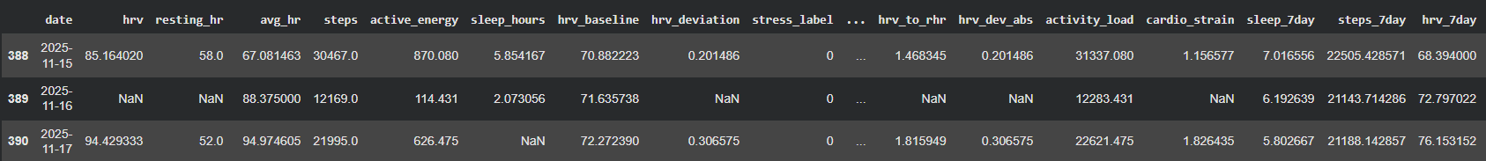
RAW DATA AFTER CLEANING

Slide 11
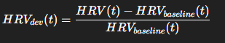
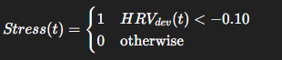
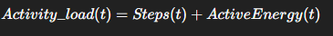
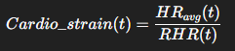
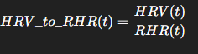
Feature / Metric | Description | Formula
HRV Baseline (14-day) | Personalized autonomic baseline used for stress detection
HRV Deviation | Measures how much HRV drops or rises relative to the baseline
Stress Label | Converts physiology into binary stress classification
Activity Load | Daily behavioral strain combining steps and energy
Cardio Strain | Indicates cardiovascular effort relative to resting HR
HRV-to-RHR Ratio | Reflects recovery; used in sports science

Slide 12
Exploratory Data Analysis

Slide 13
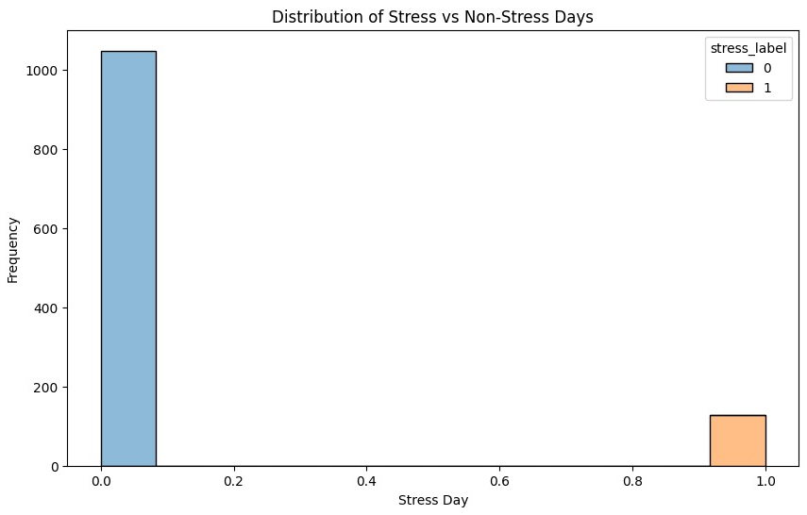
NUMBER OF STRESS AND NON-STRESS DAYS

Slide 14
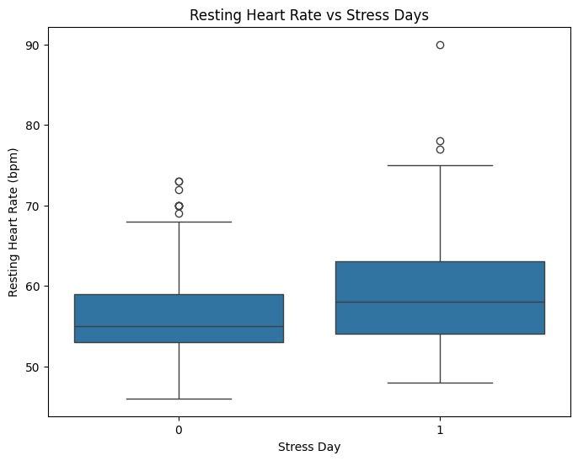
RESTING HEART RATE vs STRESS DAYS

Slide 15
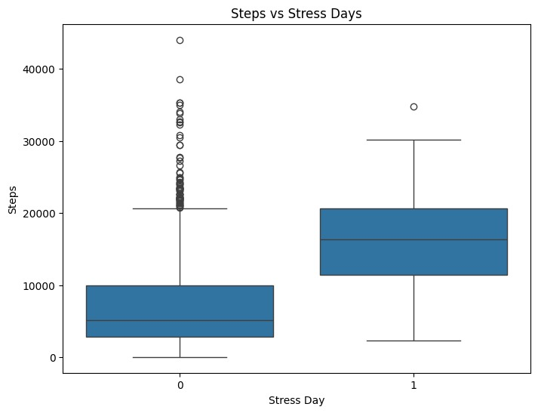
STEPS vs STRESS DAYS

Slide 16
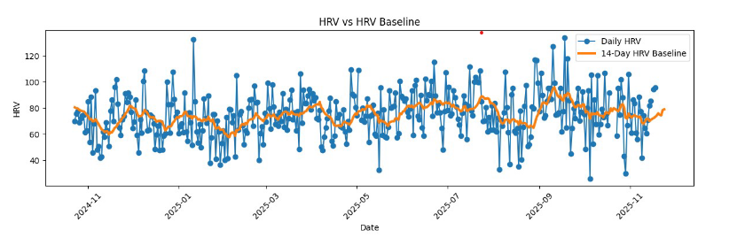
HRV vs HRV Baseline

Slide 17
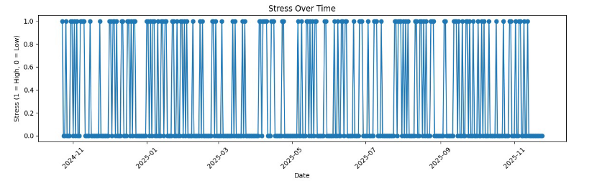
STRESS OVER TIME

Slide 18
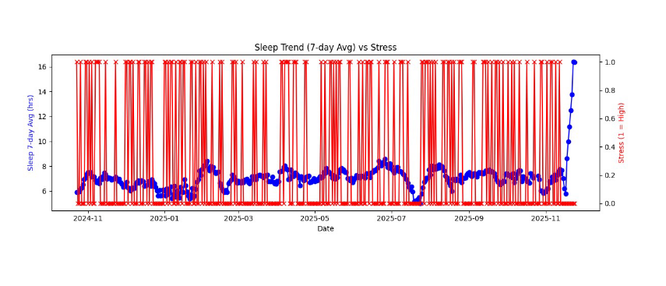
SLEEP TREND VS STRESS

Slide 19
MODELLING APPROACH
Used a 70/15/15 Training/ Validation/ Test split to preserve chronological order
Applied median imputation and standardized scaling where needed
Built two model families: Logistic Regression and Random Forest
Evaluated models using precision, recall, F1-score, and ROC-AUC

Slide 20
WHY THESE TWO MODELS?
Logistic Regression
Simple, fast, and highly interpretable
Provides clear direction of feature influence
Ideal as a baseline model for comparison
Random Forest
Captures nonlinear relationships that HRV and behavior patterns naturally exhibit
Handles feature interactions without manual tuning
Delivers higher accuracy and stronger generalization
Works well with mixed physiological and behavioral features
Together
Offers a balance between interpretability and predictive performance
Helps validate whether stress patterns are linear or more complex

Slide 21
EVALUATION METRICS
PRECISION
How often stress predictions are actually correct
RECALL
Ability to detect all true stress days (critical for health-related models)
F1-SCORE
Balances precision and recall for overall performance
ROC-AUC
Measures how well the model separates stress and non-stress days
CONFUSION MATRIX
Shows correct predictions vs. misclassifications

Slide 22
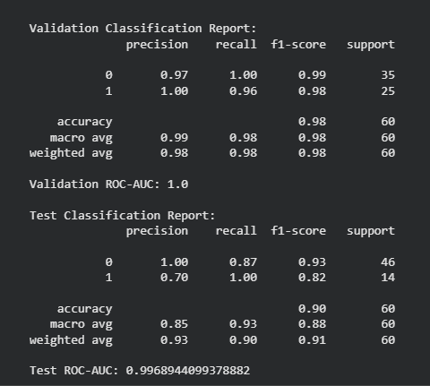
LOGISTIC REGRESSION

Slide 23
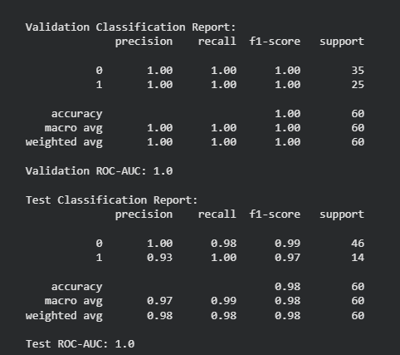
RANDOM FOREST

Slide 24
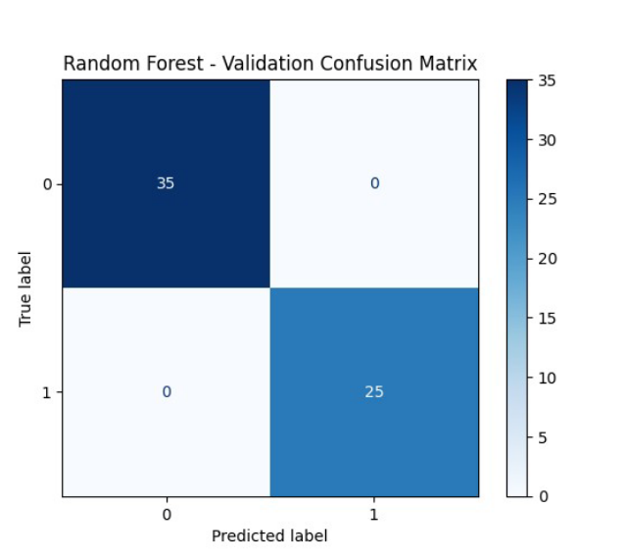
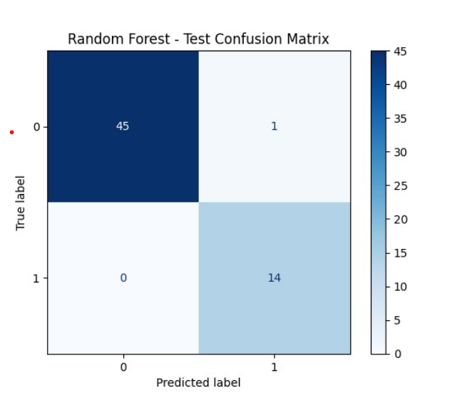
RANDOM FOREST

Slide 25
Model Comparison
KEY METRICS
 | LOGISTIC REGRESSION | RANDOM FOREST
ACCURACY | 90% | 98%
STRESS RECALL | 100% | 100%
STRESS PRECISION | 70% | 93%
ROC-AUC | 0.997 | 1.0

Slide 26
MODEL INTERPRETABILITY

Slide 27
WHY SHAP?
SHAP - SHapley Additive eXPlanations
Provides transparent, feature-level explanations for each prediction
Turns complex models like Random Forest into interpretable systems
Shows how much each feature pushes a prediction toward stress or non-stress
Helps validate that the model behaves in a physiologically meaningful way
Builds user trust by revealing the “why” behind model decisions
Identifies the most influential signals driving stress classification

Slide 28
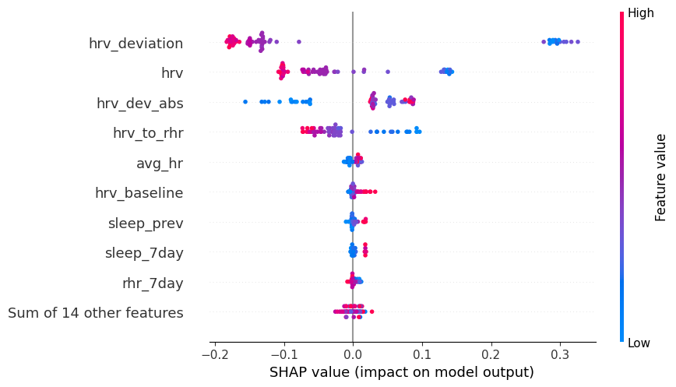
SHAP BEESWARM SUMMARY

Slide 29
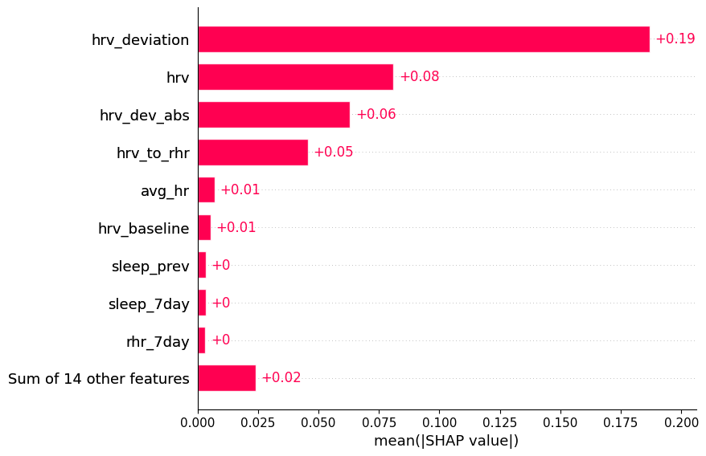
SHAP BAR PLOT

Slide 30
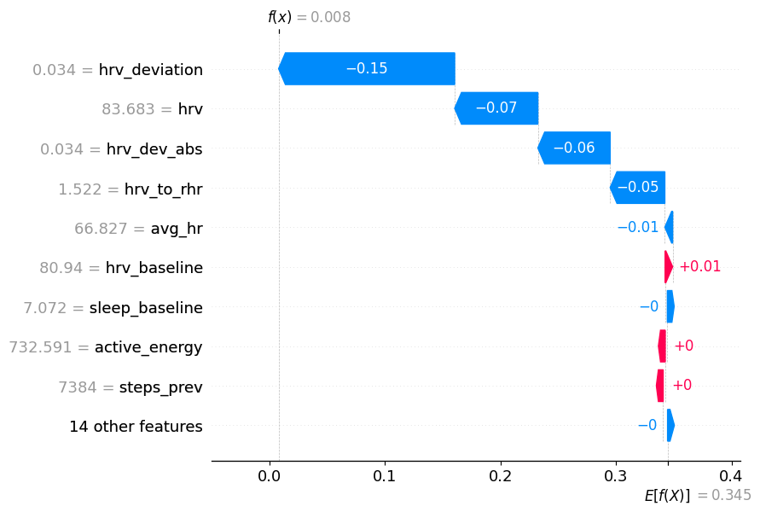
SHAP WATERFALL PLOT

Slide 31
SCALABILITY ARCHITECTURE
Designed as a modular, cloud-friendly pipeline that can support many users
Apple Health data ingested via API or periodic device sync
Daily feature generation handled by a lightweight, scalable service
Personalized HRV and sleep baselines maintained per user in a time-series database
Model served through a prediction API or deployed on-device for low latency
Batch jobs (e.g., nightly updates) orchestrated using tools like Airflow or AWS Step Functions
Architecture scales horizontally since each user’s data is processed independently
Caching recent features reduces database load and improves responsiveness

Slide 32
DEPLOYMENT OPTIONS
Cloud Deployment: Host model and APIs on AWS, GCP, or Azure for scalable, multi-user access
Serverless Functions: Use AWS Lambda or Google Cloud Functions for lightweight, low-cost inference
Containerized Services: Deploy using Docker + Kubernetes for reliable, high-traffic handling
On-Device Deployment: Convert model to CoreML for real-time predictions without sending data to the cloud
Web Dashboard: Serve insights via Streamlit, Flask, or a React-based UI
Mobile Integration: Embed predictions directly within an iOS app using HealthKit syncing
Hybrid Architecture: Perform heavy preprocessing in the cloud while keeping sensitive data local on the device

Slide 33
LIMITATIONS
Based on data from a single user, which limits generalizability
Apple Watch HRV is recorded infrequently, reducing real-time granularity
Stress label depends solely on HRV deviation and may not capture emotional stress
Wearable sensors introduce noise in sleep, steps, and heart rate measurements
Physiological patterns naturally cluster over time, potentially boosting model accuracy
FUTURE ENHANCEMENTS
Expand the model to multi-user datasets for broader validation
Integrate contextual factors (mood logs, calendar events, workload, habits)
Incorporate additional sensors like EDA, respiration, temperature, and continuous HRV
Build a real-time mobile dashboard with personalized recovery recommendations
Experiment with advanced temporal models (LSTMs, transformers, TCNs)
Add adaptive baselines that adjust with long-term lifestyle or fitness changes

Slide 34
CONCLUSION
Demonstrated that personalized stress detection is feasible using Apple Watch data
HRV baseline modeling provides a more accurate and individualized stress signal than fixed thresholds
Engineered features captured meaningful patterns in recovery, sleep, and activity load
Random Forest delivered high predictive performance with excellent generalization
SHAP made the model transparent, explaining exactly why each prediction was made
End-to-end workflow shows how raw wearable data can become actionable health insights
Establishes a foundation for scalable, real-world stress monitoring systems

Slide 35
THANK YOU !

